Slide 1
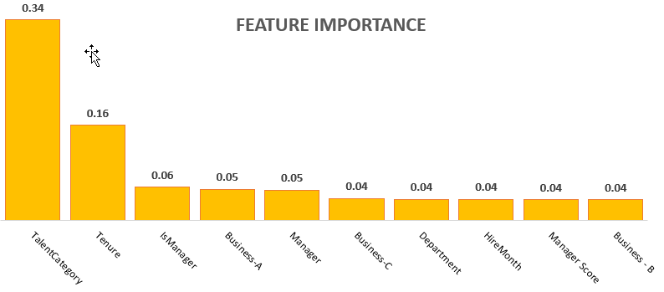
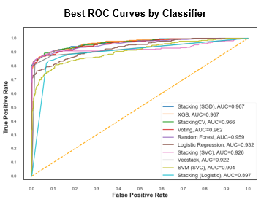
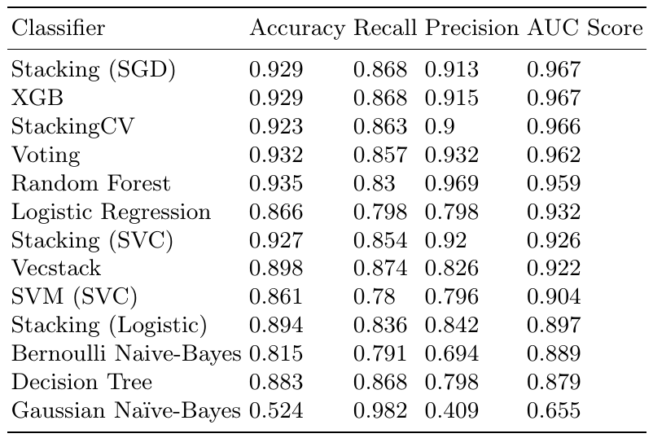

Predicting Attrition- A Driver for Creating Value, Realizing Strategy,
and Refining Key HR Processes
Kevin Mendonsa, Maureen Stolberg,
and Vivek Viswanathan
Introduction
Model Approaches and Evaluation
Strategically managed attrition is good as “Human Capital”, comprises 70 -90% of an organization’s cost
Talent is the key competitive differentiator today.
Retention and new talent is the key to growth, innovation, and success.
Attrition and turnover are key performance metrics for any organization.
Understanding the drivers of attrition are crucial to address underlying organizational issues and develop remediating strategies.
Data pre-processing: Data Imputation, one hot encoding, Scaling, Checking for correlation, up-sampling (SMOTE)
Feature reduction: Feature ranking with recursive feature elimination and cross-validated selection of the best number of features
Model Techniques: Logistic Regression, SVM, Naïve Bayes, KNN, Decision Tree and Random Forests, Ensemble Models (Vecstack, StackingCVClassifier, StackingClassifier, VotingClassifier)
Parameter Selection: Randomized search on hyper parameters – RandomizedSearchCV.
Model Effectiveness
Problem
Validation – Train-Test split, Cross-validation
Effectiveness – Accuracy, Recall, Precision and ROC scores
Aim of analysis – Reduce False Negatives, Improve recall score
Inferences – Gaussian Naïve Bayes had the least false positives but a huge false positive classification. Ensemble models were performing better than individual models. Performance of Random Forest and XGBoost models were comparable to the Ensemble models
AUC Scores: Vecstack, StackingClassifier, VotingClassifier, and RandomForest all had AUC score > 0.95
Predict Attrition by leveraging established machine learning techniques and relevant models that are most applicable to a specific organization
Identify the major factors that contribute to attrition within a firm
Provide insights into key HR processes that potentially impact employee attrition
Feature Importance
Conclusions
Talent Assessment Rating: The assigned category for every employee and importance to the firm
HireYear: This is synonymous with tenure of an employee within Company “X” was also deemed important.
Allocation to a specific business or division: The specific business that an employee worked within
Employee Category (Manager/Employee)
Employee’s Manager and department (CCID)
Manager Engagement Score
Helps convert a “lagging indicator” into a leading one.
The predictive models provide key insight into which factors are important as levers to control and manage attrition. If properly used, can be invaluable to any business looking to proactively manage attrition.
Talent, Tenure and Employee type clearly are the most important factors driving attrition at Company “X” in addition to Manager Engagement scores and Business.
It is recommended that Company “X” include additional factors to determine what other levers are available to address attrition proactively.

